Slide 1
Python Project on Traffic Signs Recognition using CNN & Keras
Khondoker Ittehadul Islam • 2016331107

Slide 2
Overview
Scope
Process
Dataset
Data Cleaning
Model
Performance
Limitation
Future Scope

Slide 3
Scope
Self-driving vehicles
Through effective understanding of traffic signs, automated car driving can be enhanced
Automated car driving is considered as the next-step of human evolution
Driver Assistance System
Moreover, drivers can have assistance when they have any limitations

Slide 4
The first stage is preparing corpus and creating a dataset
Implementing several ML models on the dataset
Evaluating performance of each of the models
Corpus
Cleaning
Implementations
Performance
Evaluation
Then cleaning the dataset for the model to interpret
Attaining performance of the models

Slide 5
Dataset
Properties
Single label classes
43 different classes
5 different attributes
Quality
Contains traffic signs of Germany
Each image has several of it’s copies, each taken with different resolutions

Slide 6
Data Cleaning
Histogram Equalization
It is a technique to standardize lightening in all our images
This is because some images are more brighter and others very dim.
Preprocessing
Converting the pixel values of all images to fit between 0 and 1 (aka normalizing)

Slide 7
Model

Slide 8
Model Details
Keras
The framework we used for implementation is Keras
CNN
4 Conv2D
2 Max_Pooling
Dropout Layer

Slide 9
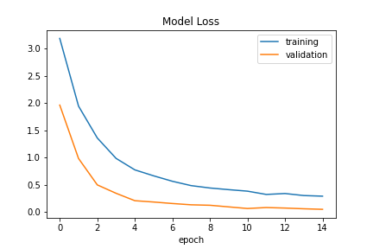
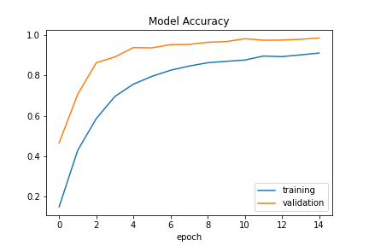
Model Performance

Slide 10
Model Evaluations
Accuracy On Test Set
Accuracy: 96.22%
Important Findings
Effective on crystal clear images
Fails to detect images with lower resolution

Slide 11
Future Scope
Train with More Traffic Signs
Model need to be trained with traffic signs of rest of the countries in the world
Implement more different models
Dataset needs to be trained on every machine learning and deep learning models available to attain better interpretability

Slide 12
Thank You

